Slide 1
Normalization Continued
Course Code: CSC 2108
Course Title: Introduction to Database
Dept. of Computer Science
Faculty of Science and Technology
Lecturer No: | 16 | Week No: | 10 | Semester: | TBA
Lecturer: | Kawser Irom Rushee & rushee@aiub.edu

Slide 2
Lecture Outline
The Normal Forms
Real World Exercise

Slide 3
Normal Form : 3NF
Third Normal Form (3NF)
Third Normal Form Rule:
A relation in Second Normal Form has no Transitive Dependency present.
Transitive Dependency
A Functional Dependency between two (or more) non-key attributes.
-Before 3NF applied
sales
cust_id | name | sales_person | region
8023 | Anderson | Smith | South
9167 | Boston | Hikes | West
7924 | Haile | Smith | South
6837 | Tuck | David | East
8596 | Haile | Hikes | West
7018 | Anderson | Forth | North

Slide 4
Third Normal Form (3NF)
After 3NF
sales
cust_id | name | sale_person
8023 | Anderson | Smith
9167 | Boston | Hikes
7924 | Haile | Smith
6837 | Tuck | David
8596 | Haile | Hikes
7018 | Anderson | Forth
salesman
sale_person | region
Smith | South
Hikes | West
David | East
Forth | North

Slide 5
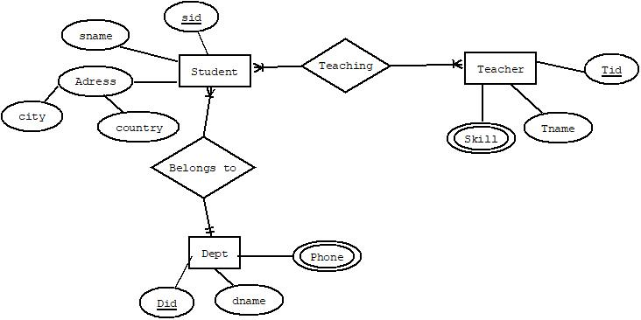
Normalization from ER diagram
Exercise

Slide 6
Books
Modern Database Management (Sixth Edition) by Fred R. McFadden, Jeffrey A. Hoffer, Mary B. Prescott
Database System Concepts (Fifth Edition) by Henry F. Korth, S. Sudarshan, A. Silberschatz
Oracle-database-10g-sql-fundamentals-1-student-guide-volume-1
SQL and Relational Theory: How to Write Accurate SQL Code by C.J. Date
Database Systems: A Practical Approach to Design, Implementation and Management (4th Edition) by Thomas M. Connolly, Carolyn E. Begg
Fundamentals of Database Systems, 5th Edition by RamezElmasri, Shamkant B. Navathe
Database Design and Relational Theory: Normal Forms and All That Jazz by C. J. Date
An Introduction to Database Systems 8th Edition, by C.J. Date

Slide 7
References
https://www.db-book.com/db6/slide-dir/index.html
https://docs.oracle.com/en/database/oracle/oracle-database/20/sqlrf/SQL-Standards.html#GUID-BCCCFF75-D2A4-43AD-8CAF-C3C97D92AC63
https://www.slideshare.net/HaaMeemMohiyuddin1/data-knowledge-and-information
https://www.slideshare.net/tabinhasan/from-data-to-wisdom
https://www.slideshare.net/thinnaphat.bo/

